Slide 1
JHARKHAND BIJLI VITRAN NIGAM LIMITED (JBVNL) ABAP Training

Slide 2
ABAP Training Day 1

Slide 3
Agenda
Introduction to ABAP
What is SAP
SAP Architecture
Data Dictionary
Data Base Tables
View
Data Types
Type Group
Domain
Search Help
Lock Objects

Slide 4
What is SAP
SAP (System Application and Product) is the name of the biggest European German Software company as well as the name of software itself.
The company was founded in 1972 by the five IBM employees. SAP R/3 Software has been developed using ABAP/4 as a programming language.
SAP is the ERP (Enterprise Resource Planning) system that aims to integrate all the different modules(SD,MM,CO,HR etc.) in the company. The integration results in consistency of data through out the system and the company as a whole.

Slide 5
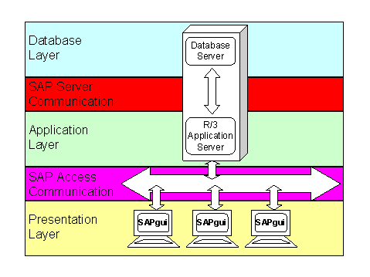
What is SAP
SAP R/3 is one of the main product of SAP
where R stands for Real Time and the number 3 relates to three tier application architecture(Data base, Application Server and Client).

Slide 6
SAP R/3 Architecture
Smaller applications keep the database and the R/3 application on the same host. The large volume of data that passes between the R/3 application and the database (SAP server communication) is processed locally and not through a network
The presentation layer is usually made up of PCs on which the SAP GUI frontend is installed. The SAP Gui is not a terminal emulation but an application program that displays R/3 application data graphically. This means that there are no great demands placed on the connection between the SAPgui frontend PCs and the R/3 application (access communication).

Slide 7
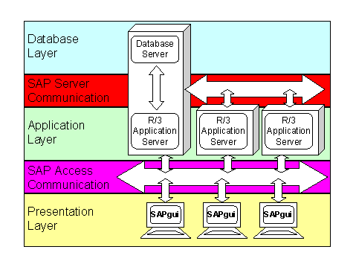
SAP R/3 Architecture
Higher processing demands on the R/3 application can be realized by additional application servers.

Slide 8
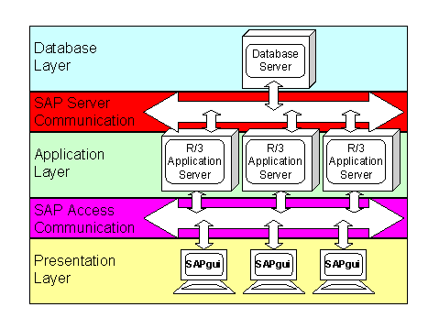
SAP R/3 Architecture
You can speed up and secure data throughput to the database by placing the database on a separate host. The database server host then communicates only with the R/3 application servers. By isolating the database completely from the rest of the corporate network, you prevent unauthorized access to sensitive data and ensure high performance
For data backup purposes you may need to connect the database server to a dedicated network (SAN = Storage Area Network).

Slide 9
Introduction to ABAP
Allgemeiner Berichts-Aufbereitungs-Prozessor
A ADVANCED
B BUSINESS
A APPLICATION
P PROGRAMMING

Slide 10
DATA DICTIONARY
ABAP Dictionary to create and manage data definitions (metadata). The ABAP Dictionary permits a central description of all the data used in the system without redundancies. New or modified information is automatically provided for all the system components. This ensures data integrity, data consistency and data security.
The ABAP Dictionary supports the definition of user-defined types (data elements, structures and table types). You can create the corresponding objects (tables or views) in the underlying relational database using these data definitions. The ABAP Dictionary describes the logical structure of the objects used in application development and shows how they are mapped to the underlying relational database in tables or views.
The ABAP Dictionary also provides standard functions for editing fields on the screen, for example for assigning input help to a screen field.

Slide 11
DATABASE TABLES
Tables can be defined independently of the database in the ABAP Dictionary. The fields of the table are defined with their (database-independent) data types and lengths.
The table is activated, the system creates a physical table definition in the database for the table definition stored in the ABAP Dictionary. The system translates the table definition from the ABAP Dictionary to a definition of the particular database.

Slide 12
DATABASE TABLES
A table definition in the ABAP Dictionary contains the following components
Table Fields:
Table fields define the field names and data types of the fields contained in the table
Foreign keys:
Foreign keys define the relationships between the table and other tables.
Technical settings:
Technical settings control the creation of the table in the database.
Indexes:
To speed up data selection, secondary indexes can be created for the table.
The customer can modify SAP tables with append structures and customizing includes. This kind of modification ensures that the customer enhancements are automatically merged with the new versions of the SAP tables when there is a release upgrade.

Slide 13
Types Of Table
Transparent Table
Cluster Table
Pool Table

Slide 14
Transparent Table
One to one relation
One table in data dictionary equal to one table in data base.
When u create one transparent table in ABAP dictionary one table will be created in Database with same name(Both table and fields).
Basically used to hold application data.
EG: EKKO,VBAK etc.

Slide 15
Cluster Table
Many tables in ABAP dictionary equal to one table cluster in database. Basically used to hold application data. One table cluster contains few number of cluster tables having data of around large quantities.(In lakhs)
Eg: CDPOS, BSEG etc

Slide 16
Pool Table
Many to one relationship
Many tables in ABAP dictionary equal to one table pool in database. Basically used to hold system data and customization data. One table pool contains large number of pooled tables having data of around 100 records each

Slide 17
VIEW
Platform-dependent definition of a classic view in the ABAP Dictionary.
Classic views are:
DATABASE VIEW
PROJECTION VIEW
MAINTENANCE VIEW
HELP VIEW

Slide 18
DATABASE VIEW
Views are implemented with an equivalent view on the database. A database view is automatically created in the underlying database when it is activated. Database views implement an inner join.
Important points to note about database views
- At least one relationship is required.
- No modification can be done. Read only.
- Implements an inner joins.

Slide 19
PROJECTION VIEW
Projection views are used to hide fields of a table. This can minimize interfaces; for example when you access the database, you only read and write the field contents actually needed.
Important points to note about projection views
- It is used for only one table.
- You cannot define selection conditions for projection views.
- Modification (create, delete, insert, and update) can be done.
- You can also access pooled tables & cluster tables with a projection view.

Slide 20
MAINTENANCE VIEW
Maintenance Views you can also change/edit data. Thus, a maintenance view allows you to maintain the data of an application object together.
All the tables in a maintenance view must be linked with foreign key. The join conditions for maintenance views are always derived from the foreign key.
You cannot directly enter the join conditions as for database views.
Important points to note about maintenance views
- 'N' no. of relationship can support.
- Modification can be done.
- Implements an outer join.

Slide 21
HELP VIEW
Help views can be used in search helps as a selection method.
For Example - You may have to create a help view if a view with outer join is needed as selection method of search help.
Important points to note about Help views
- It implements an outer join.

Slide 22
Data Type
Definition of a global data type in the ABAP Dictionary.
Possible data types are:
Data elements with or without domains
Structures
Table types

Slide 23
Data Element
Data Element defines the data type, structure component, field labels, search help, search help etc. There are two types in which data element is describe –
Elementary Type, and
Reference Type.
Elementary type is define by the built-in data type, field length and decimal places. Whereas Reference type defines the type of reference variable in ABAP program.
Data Element is used for defining -
1. Data Type
2. Field Label
3. Search Help
4. Parameter ID
5. Change document flag
6. Further Characteristics

Slide 24
Domain
A domain describes the technical attributes of a field, such as the data type or the number of positions in a field. The domain defines primarily a value range describing the valid data values for the fields referring to this domain.
You can define following thing in domain-
In Definition Tab
1. Data Type
2. No. Of Characters
3. Decimals
4. Output length
5. Conversion Routine
6. Sign (a check box)
7. Lowercase (a check box)
In Value Range Tab
1. F4 Help fixed Ranges
2. Value Table

Slide 25
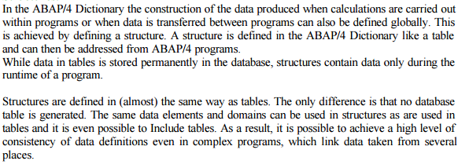
Structure

Slide 26
Search Help
Search helps are objects that you can use to assign input help (F4 Help) to screen fields. You can do this by creating a search help in the ABAP Dictionary and attaching it to the corresponding screen field
The input help (F4 help) is a standard function of the SAP system. You can display the list of all possible input values for a screen field using input help. You can enhance the possible input values with further information. This is meaningful especially when the field requires the input of a formal key.
To understand the functionality of search helps in detail, you have to be familiar with the standard input help process.
Standard Input Help Process
You call an input help with the following steps (some steps can be omitted, depending on the definition of the input help):
You start the input help to display the possible input values for a field (search field) in a screen template.
The system offers you a number of possible search paths. You have to select one of these search paths. Each search path offers a number of restrictions to limit the number of possible input values. These values are offered in a Dialog box for value restriction when the search path is selected.
Enter the restrictions, if required, and then start the search.

Slide 27
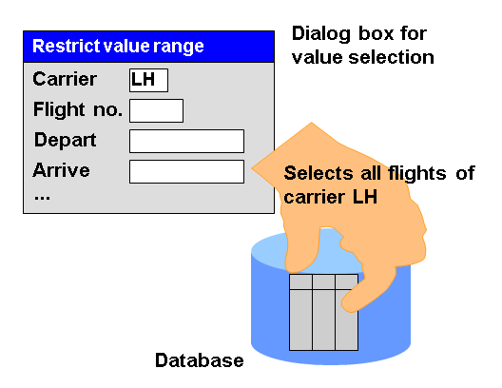
Search Help – Example

Slide 28
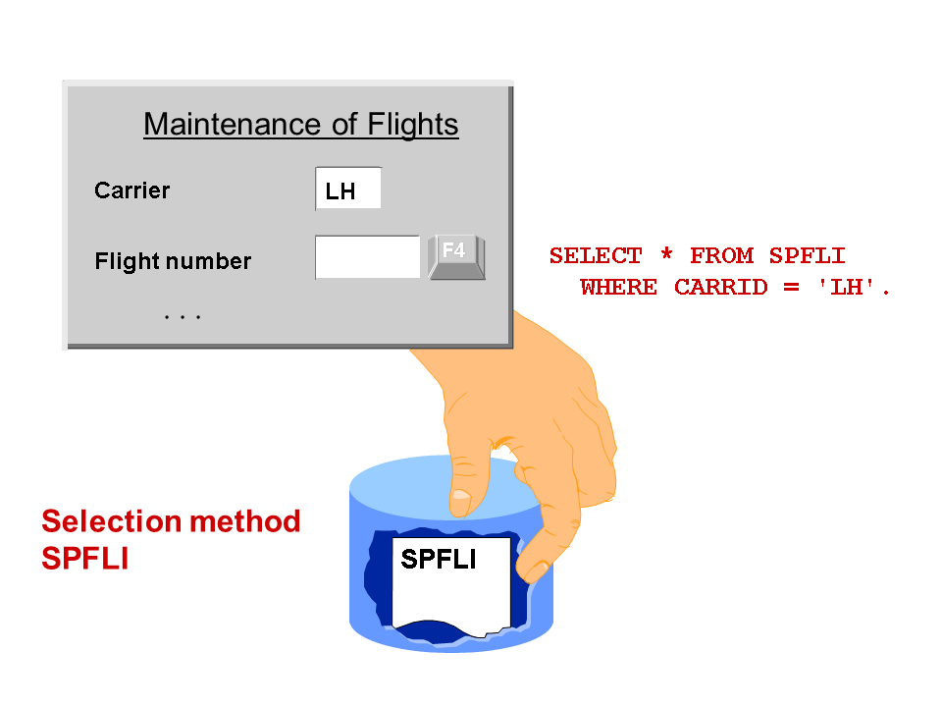
Search Help – Elementary
An elementary search help defines the standard flow of an input help. You can define the following components of this flow in the search help:
Where does the data displayed in the hit list come from (selection method)
Which information must be displayed in the dialog box for value selection and in the hit list (search help parameters)
Which field contents can be taken into account for hit list selections and which values in the hit list can be returned to the screen fields (search help parameters)
Which dialog steps must be executed in the input help (dialog behaviour)

Slide 29
Search Help – Collective
A collective search help combines several elementary search helps. You can choose one of several alternative search paths with a collective search help.
When you define a collective search help, you have to specify only the search helps that are to be combined in the collective search help. In the input help, the values are transported between the selected elementary search help and the input template using the collective search help. This is the reason why a collective search help also has an interface for transporting the values

Slide 30
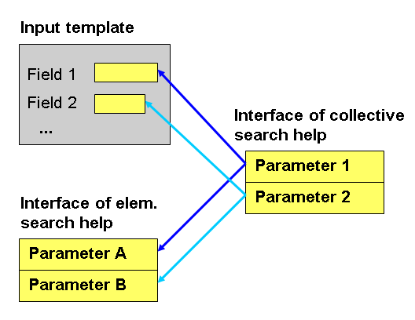
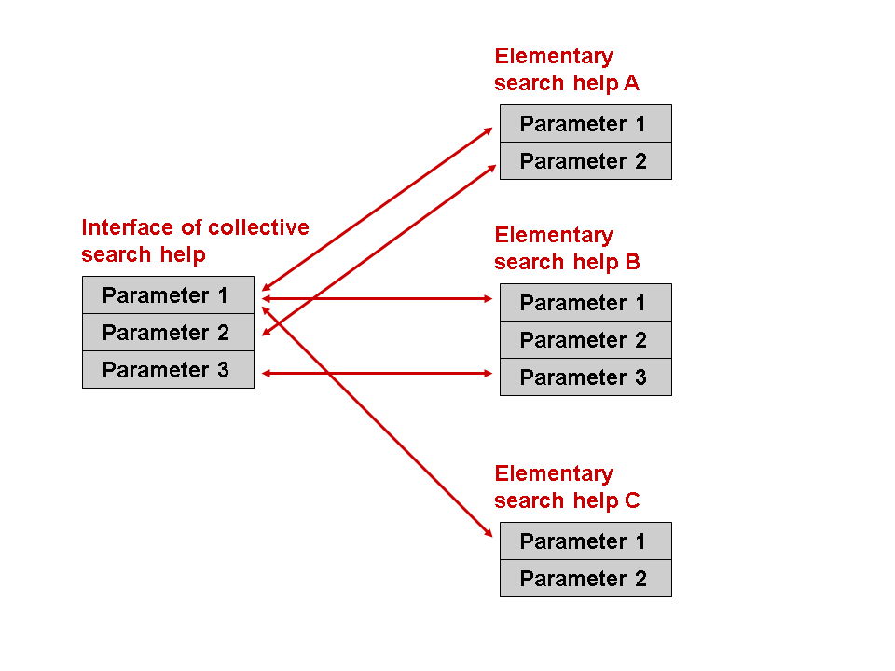
Search Help – Collective
Like an elementary search help, a collective search help has an interface of import and export parameters. The data is exchanged between the screen template and the parameters of the assigned elementary search helps using this interface. The following figure simply explains how this data exchange is done.

Slide 31
Lock Object
Lock objects are use in SAP to avoid the inconsistency at the time of data is being insert/change into database.
SAP Provide three type of Lock objects.
Read Lock (Shared Locked) Protects read access to an object. The read lock allows other transactions read access but not write access to the locked area of the table
Write Lock (exclusive lock)
Protects write access to an object. The write lock allows other transactions neither read nor write access to the locked area of the table.
Enhanced write lock (exclusive lock without cumulating) Works like a write lock except that the enhanced write lock also protects from further accesses from the same transaction.

Slide 32
Lock Object
When you create a lock object System automatically create two function module. 1. ENQUEUE_<Lockobject name>. to insert the object in a queue. 2. DEQUEUE_<Lockobject name>. To remove the object is being queued through above FM. You have to use these function module in your program.
Structure of a Lock Object The tables in which data records should be locked with a lock request are defined in a lock object together with their key fields. When tables are selected, one table (the primary table) is first selected. Further tables (secondary tables) can also be added using foreign key relationships
The user goes to VA02 to change a sales order, in this program, a lock is set. You can see such locks in transaction SM12. If a lock is set, and another user accesses the same sales order, then they will get a message saying that the sales order is locked. The ENQUEUE function module is used to set the lock, the DEQUEUE function module is to release the lock.

Slide 33
ABAP Training Day 2

Slide 34
Agenda
Declaration
Variables and Data types
ABAP Standard Data Types
Variable Declaration
Local Data Types
Global Data type
Constants
Structure
Internal Table / Work Area
Selection Screen / Input Fields
Parameter
Select-Option
Events

Slide 35
Agenda
Conditional Execution
Condition
Case
Looping

Slide 36
Variables and Data type
Data type: description of the kind of data a variable may hold and the range of acceptable values based on storage allocated.
Data object: actual variable or constant (of a stated type) that has been defined.
Complete Data Types
Fixed size, specified format data storage.
Incomplete Data Types
Storage size can vary, so must be set upon variable declaration.

Slide 37
ABAP Standard Data types
I integer 4 byte whole number +/- 2.1 billion
F float 8 bytes, 15-16 significant digits
C string up to 65k characters
N numeric string up to 65k characters (non-math number)
STRING string dynamic length up to 2 GB long!
XSTRING hex string dynamic length byte sequence
X byte sequence up to 65k bytes
D date 8 characters in form YYYYMMDD
T time 6 characters in from HHMMSS
P packed number precise whole or floating number up to 16 bytes
Bold italics indicate incomplete data types (size set on declaration)

Slide 38
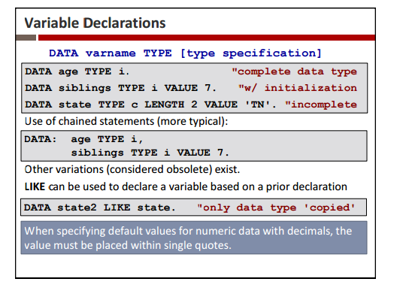
Variables Declaration

Slide 39
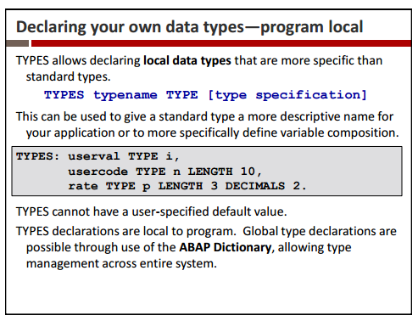
Local Data Types

Slide 40
Global Data Types

Slide 41
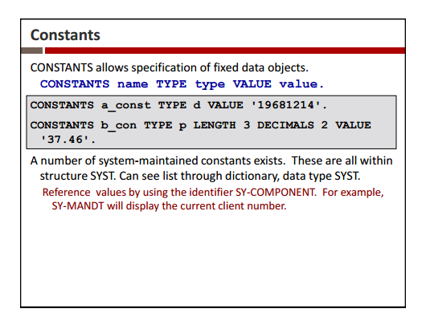
Constants

Slide 42
Structure
Structures consist of a fixed number of data objects called components of the record
They are declared using data begin of and data end of
DATA: BEGIN OF STUDENT,
STNUM(8) TYPE N,
STNAME(25) TYPE C,
STDOB LIKE SY-DATUM,
STPHONE(12) TYPE N,
END OF STUDENT.
components of structures are referenced by structname-componentname
DATA STUDENT2 LIKE STUDENT.
STUDENT-STNUM = '12345678'.
STUDENT-STNAME = 'F.Jones'.
STUDENT-STDOB = '19790623'.
STUDENT-STPHONE = '3221 1278'.
MOVE STUDENT TO STUDENT2.

Slide 43
Structure - TYPES
used to create a user-defined type
TYPES: BEGIN OF STUDENT_TYPE,
STNUM(8) TYPE N,
STNAME(25) TYPE C,
STDOB LIKE SY-DATUM,
STPHONE(12) TYPE N,
END OF STUDENT_TYPE.
DATA: STUDENT_REC TYPE STUDENT_TYPE.

Slide 44
Structure – Complex
It is possible to create nested structures
a structure can contain another structure
a record can contain an internal table as one of its components
a table can contain another table
TYPES: BEGIN OF ADDR_TYPE,
CITY(25),
STREET(30),
END OF ADDR_TYPE,
BEGIN OF PERSON,
NAME(25),
ADDRESS TYPE ADDR_TYPE,
END OF PERSON.
DATA: EMP TYPE PERSON.
EMP-ADDRESS-CITY = 'Sydney'.

Slide 45
Internal Table
Declaring internal tables is an essential part of writing ABAP code as this is where most of the data retrieved from database tables will be stored. During the select statement you retrieve data from a database table into an internal table (multiple rows) or a work area or header line (single row).
* Table declaration (old method)
DATA: BEGIN OF tab_ekpo OCCURS 0, "itab with header line
ebeln TYPE ekpo-ebeln,
ebelp TYPE ekpo-ebelp,
END OF tab_ekpo.
*Table declaration (new method) "USE THIS WAY!!!
TYPES: BEGIN OF t_ekpo,
ebeln TYPE ekpo-ebeln,
ebelp TYPE ekpo-ebelp,
END OF t_ekpo.

Slide 46
Internal Table
DATA: it_ekpo TYPE STANDARD TABLE OF t_ekpo INITIAL SIZE 0,
wa_ekpo TYPE t_ekpo. "work area (header line)
* Build internal table and work area from existing internal table
DATA: it_datatab LIKE tab_ekpo OCCURS 0, "old method
wa_datatab LIKE LINE OF tab_ekpo.
* Build internal table and work area from existing internal table,
* adding additional fields
TYPES: BEGIN OF t_repdata.
INCLUDE STRUCTURE tab_ekpo. "could include EKKO table itself!!
TYPES: bukrs TYPE ekpo-werks,
bstyp TYPE ekpo-bukrs.
TYPES: END OF t_repdata.
DATA: it_repdata TYPE STANDARD TABLE OF t_repdata INITIAL SIZE 0, "itab
wa_repdata TYPE t_repdata. "work area (header line)

Slide 47
WorkArea
Workarea is a collection of fields which can be of different data types. And we can store maximum of one record at a time.
Data Storage in workarea is temporary.
*// WORK AREA DECLARATION BY REFERRING STANDARD DATABASE TABLE
DATA: WA_MARA TYPE MARA.
*// DECLARING WORKAREA BY USING INCLUDE STRUCTURE
DATA: BEGIN OF WA_MARA1.
INCLUDE STRUCTURE MARA.
DATA: END OF WA_MARA1.

Slide 48
Work Area
*// DECLARING WORKAREA BY USING TYPES DECLARATION
TYPES: BEGIN OF TY_MARA,
MATNR TYPE MARA-MATNR,
ERSDA TYPE MARA-ERSDA,
END OF TY_MARA.
DATA: WA_MARA2 TYPE TY_MARA.
*// WORKAREA DECLARATION BY USING NORMAL METHOD
DATA: BEGIN OF WA_MARA3,
MATNR TYPE MARA-MATNR,
ERSDA TYPE MARA-ERSDA,
END OF WA_MARA3.

Slide 49
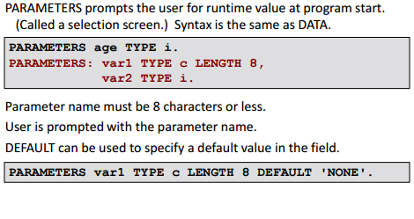
Parameters

Slide 50
Parameters

Slide 51
Parameters - Example
Example:
REPORT SAPMZTST.
TABLES SPFLI.
PARAMETERS : WORD(10) TYPE C,
DATE TYPE D,
NUMBER TYPE P DECIMALS 2,
CONNECT Like SPFLI-CONNID.
This example creates four fields, namely a character field, WORD, of length 10; a date field, DATE of length 8; a packed number field, NUMBER, with two decimals; and a field, CONNECT, which refers to the ABAP/4 Dictionary structure SPFLI-CONNID. When the user starts the report SAPMZTST, input fields to the four declared fields will appear on the selection screen as follows

Slide 52
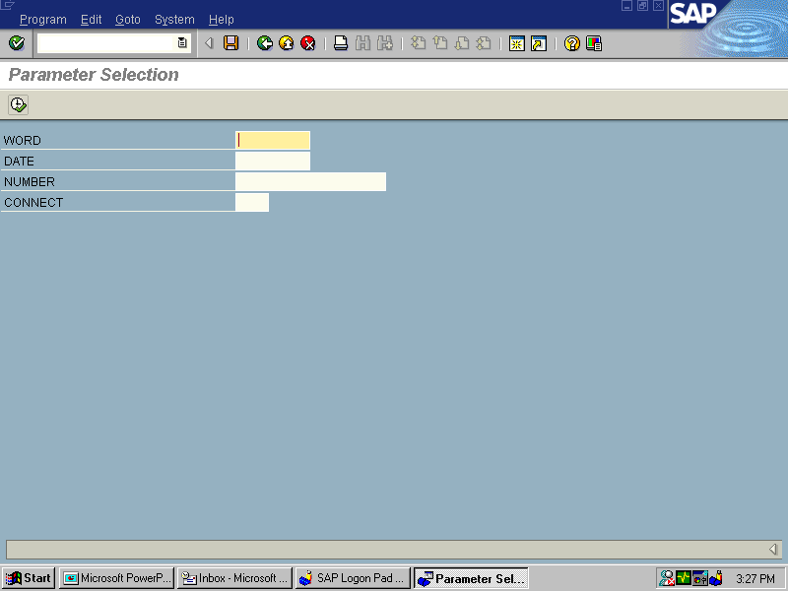
Parameters - Example

Slide 53
Parameters - Variants
Variants of Parameters statements are:
PARAMETERS <p> ...... DEFAULT <f> ......
PARAMETERS <p> ...... NO-DISPLAY ......
PARAMETERS <p> ...... LOWER CASE ......
PARAMETERS <p> ...... OBLIGATORY ......
PARAMETERS <p> ...... AS CHECKBOX ......
PARAMETERS <p> ...... RADIOBUTTON GROUP <radi>......

Slide 54
Select - Options
The SELECT-OPTIONS statement, the report user can enter the selection criteria on the selection screen.
During its definition, you normally attach a selection criterion to a specific column of a database table that must be declared in the program.
If you want to program complex selections, selection criteria, stored in special internal tables, are preferable to the PARAMETERS statement because they relieve you from coding them in lengthy WHERE conditions.
SELECT-OPTIONS statement
Syntax
SELECT-OPTIONS <seltab> FOR <f>.

Slide 55
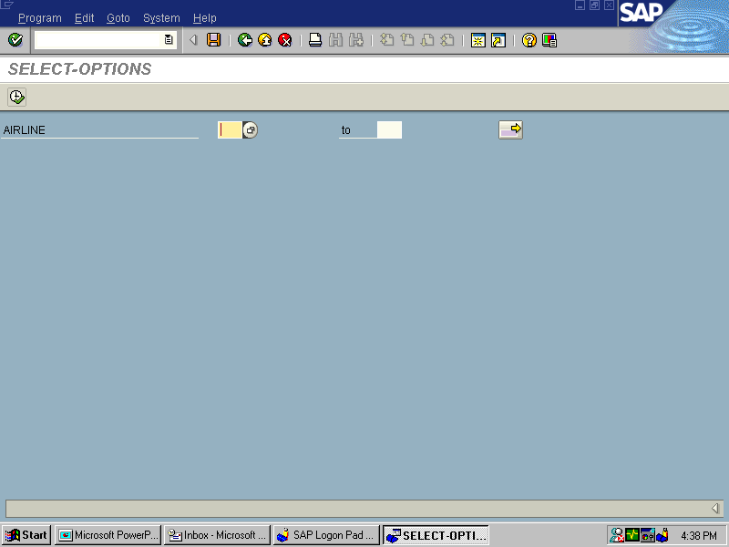
Select - Options

Slide 56
Select – Options - Note
The field <f> cannot have data type F. The data type F is not supported on the selection screen.
For SELECT-OPTIONS statement, the system creates a selection table. The purpose of selection tables is to store complex selection limits in a standardized manner.
Their main purpose is to transfer the selection criteria directly to database tables using the WHERE clause of Open SQL statements.
Selection table
It is an internal table(with name <seltab>) with a header line. Its line structure is a field string of four components,

Slide 57
Select – Options - Varaints
The SELECT-OPTIONS statement has several variants which are:
SELECT-OPTIONS <seltab> FOR <f> DEFAULT <g> [TO <h>] ....
SELECT-OPTIONS <seltab> FOR <f> ... NO-EXTENSION .....
SELECT-OPTIONS <seltab> FOR <f> ... NO INTERVALS .....
SELECT-OPTIONS <seltab> FOR <f> ... NO-DISPLAY ..............
SELECT-OPTIONS <seltab> FOR <f> ... LOWER CASE ..............
SELECT-OPTIONS <seltab> FOR <f> ... OBLIGATORY ..............

Slide 58
Select – Options - Example
REPORT SAPMZTST.
TABLES SPFLI.
SELECT-POTIONS AIRLINE FOR SPFLI-CARRID.
LOOP AT AIRLINE.
WRITE : / ‘SIGN:’, AIRLINE-SIGN,
‘OPTION:’, AIRLINE-OPTION,
‘LOW:’, AIRLINE-LOW,
‘HIGH:”, AIRLINE-HIGH.
ENDLOOP.

Slide 59
Select – Options - Example
REPORT SAPMZTST.
TABLES SPFLI.
SELECT-POTIONS AIRLINE FOR SPFLI-CARRID.
LOOP AT AIRLINE.
WRITE : / ‘SIGN:’, AIRLINE-SIGN,
‘OPTION:’, AIRLINE-OPTION,
‘LOW:’, AIRLINE-LOW,
‘HIGH:”, AIRLINE-HIGH.
ENDLOOP.

Slide 60
Events
INITIALIZATION Point before the selection screen is displayed
AT SELECTION-SCREEN Point after processing user input on the selection screen while the selection screen is still active
START-OF-SELECTION Point after processing the selection screen
GET <table> Point at which the logical database offers a line of the database table <table>.
END-OF-SELECTION Point after processing all lines offered by the logical database.

Slide 61
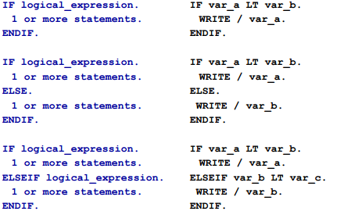
Conditions

Slide 62
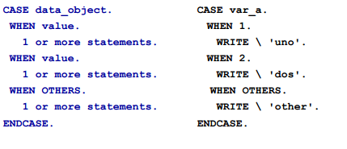
Conditions - Case

Slide 63
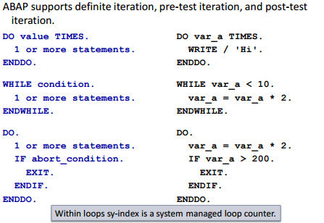
Looping

Slide 64
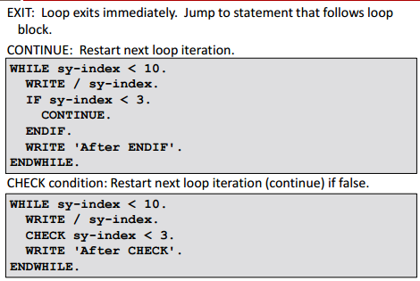
Existing Looping

Slide 65
ABAP Training Day 3

Slide 66
Agenda
Dialog Programming
Introduction to Dialog Programming
Screen Painter
Menu Painter
Sub Screen
Tabstrips
Table Control
Function Keys
Screen Flowlogic
Creating Transaction

Slide 67
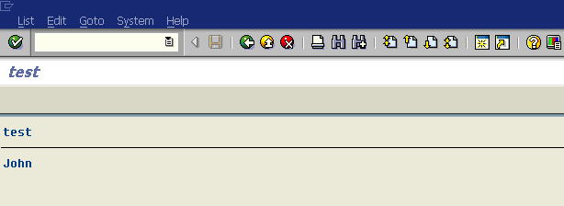
SAP System : Dialog Programming (Dialog)
Report zpsm1.
Tables customers.
Select single * from
customers where id = 1.
Write: / customers-name.
Request
List
Generate Screen(List)
1
10
Application Server
Send Request
Store request to queue
Dispatcher
3
Send List
2
Search for free WP
Request
Queue
9
Check Program in Program Buffer
Program
7
Send request to WP
5
Execute ABAP statement
4
…
D
D
D
…
D
…
8
6
SQL Request
Load&Gen Program
Database Server

Slide 68
Dialog WP : Dialog Program
Dialog WP
Local Memory
TaskHandler
Memory Space
ABAP Processor
List Buffer
DYNPRO Processor
DB Interface
Result Set Memory
Database

Slide 69
Dialog Program : Transaction

Slide 70
Dialog Program Components
Transaction Code
Dialog Program
Program Naming Convention : SAPM…
Screen : 100
(Screen Layout)
ABAP Module Pool
PBO
Flow Logic
PAI
ABAP Module Pool
Screen : 200
(Screen Layout)
PBO
ABAP Module Pool
Flow Logic
PAI
ABAP Module Pool

Slide 71
SAP Transaction
An SAP transaction consists of Dialog steps. A Dialog step begins when the user press Enter, activates a function by pressing a function key, double-clicks or chooses a function from a menu. It ends when the next screen is display
In the course of a Dialog step, The PAI modules belonging to the current screen and the PBO modules belonging to the next screen

Slide 72
Data Transfer (Local Memory)
Local Memory
Screen Work Area
ABAP Work Area
ok_code
Screen Buffer
ABAP Memory Space
PBO
Element List
customers
id name city …
customers-id
0000000
customers-name
PAI
ok_code

Slide 73
Flow Logic
Process Before Output(PBO)
After it has processed all of the modules in the PBO processing block, the system copies the contents of the fields in the ABAP work area to their corresponding fields in the screen work area.
Process After Input(PAI)
Before it processes the first module in the PAI processing block, the system copies the contents of the fields in the screen work area to their corresponding fields in the ABAP work area.
Process on Help-Request (POH) : F1 Help
Whenever F1 is pressed the POH event for the specified data element is executed. If the PROCESS ON HELP-REQUEST event does not exist in the process logic of a screen, the documentation of the field in the ABAP Dictionary is taken as a basis and displayed. Even if that does not exit no help is displayed.
Process on Value (POV) : F4
When the user chooses the function Possible entries (F4), the system displays the possible input values for a field (values, check table, matchcode), provided they were stored by the developer. The event PROCESS ON VALUE-REQUEST is always processed if the user has called "Possible entries".

Slide 74
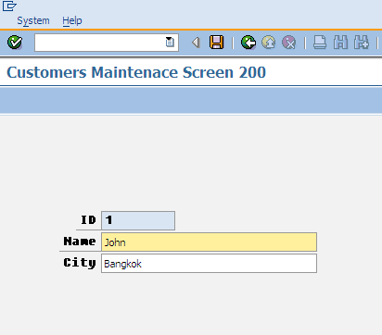
OK Code Field in Selection
OK Code Field or
Command Field
(ok_code in Element List)

Slide 75
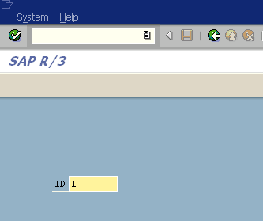
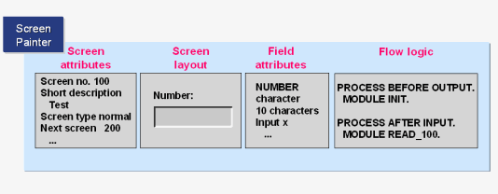
Defining Screen ( 4 Steps)
Screen Attribute
Screen Layout
Flow Logic
Element List
Element List(ok_code field)

Slide 76
How to Create Dialog Program
Transaction SE80 : Create Dialog Program
Create Screen(4 steps)
Screen Attribute
Screen Layout
Flow Logic(PBO,PAI)
Define Variable ok_code in Element List
Define Data Object in ABAP Work Area at TOP Include(Tables, Data,...)
Check and Activate Dialog Program
Create Transaction Code

Slide 77
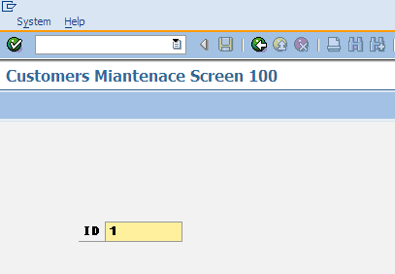
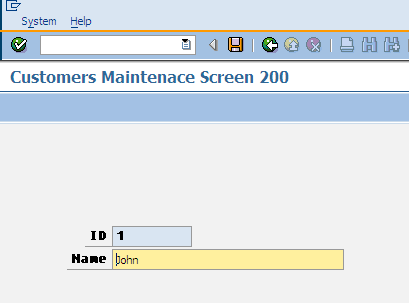
Example 1 – Maintain Customers Data
Screen : 100
Screen : 200

Slide 78
Example 1
Create Dialog Program SAPMZEX<nn> for changing Customers table
Screen 100
Field customers-id
Screen 200
Field customers-id and customers-name
Screen 100
PROCESS BEFORE OUTPUT.
MODULE STATUS_0100.
PROCESS AFTER INPUT.
MODULE USER_COMMAND_0100.

Slide 79
Example 1
Screen 100
MODULE status_0100 OUTPUT.
SET PF-STATUS ‘0100’.
SET TITLEBAR ‘0100’.
ENDMODULE.
Screen 100
MODULE user_command_0100 INPUT
CASE ok_code.
WHEN ‘BACK’.
LEAVE PROGRAM. “leave to screen 0
WHEN space. “if not assign Enter Key
SELECT SINGLE * FROM customers
WHERE id = customers-id.
LEAVE TO SCREEN 200.
ENDCASE.
ENDMODULE.

Slide 80
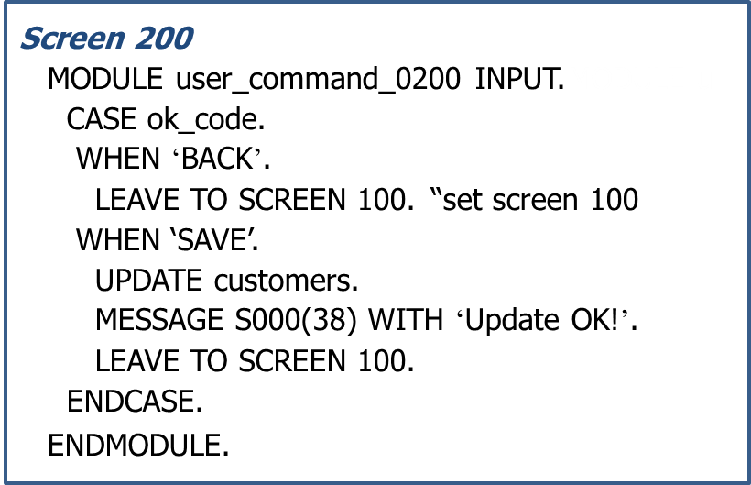
Example 1
Screen 200
PROCESS BEFORE OUTPUT.
MODULE STATUS_0200.
PROCESS AFTER INPUT.
MODULE USER_COMMAND_0200.
Screen 200
MODULE status_0200 OUTPUT.
SET PF-STATUS ‘0200’.
SET TITLEBAR ‘0200’.
ENDMODULE.

Slide 81
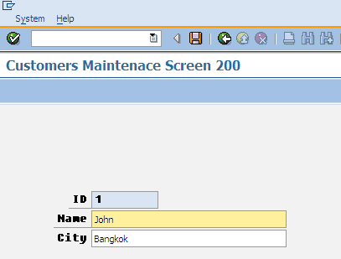
Exercise : Customers Maintenance
Create Dialog Program : SAPMZCUST<nn>
Transaction Code : ZCUST<nn>
Screen : 100

Slide 82
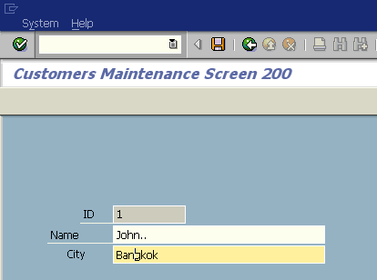
Setting the Cursor Position Dynamically
PROCESS BEFORE OUTPUT.
MODULE STATUS_0200.
MODULE set_cursor.
MODULE set_cursor OUTPUT.
SET CURSOR FIELD ‘CUSTOMERS-CITY’
OFFSET 3.
ENDMODULE.
Cursor Position

Slide 83
Avoiding the Unexpected Processing Step of ok_code Field
TOP Include
TABLES customers.
DATA ok_code TYPE sy-ucomm.
DATA save_ok TYPE sy-ucomm.
Screen 100 : PAI
MODULE user_command_0100 INPUT.
save_ok = ok_code.
CLEAR ok_code.
CASE save_ok.
WHEN ‘BACK’.
LEAVE PROGRAM.
WHEN space.
SELECT SINGLE * FROM customers WHERE id = customers-id.
LEAVE TO SCREEN 200.
ENDCASE.
ENDMODULE.

Slide 84
Avoiding the Unexpected Processing Step of ok_code Field
Screen 200 : PAI
MODULE user_command_0200 INPUT.
save_ok = ok_code.
CLEAR ok_code.
CASE save_ok.
WHEN ‘BACK’.
LEAVE TO SCREEN 100.
WHEN space.
LEAVE TO SCREEN 200.
WHEN ‘SAVE’.
UPDATE customers.
MESSAGE s000(38) WITH ‘Update OK!’.
LEAVE TO SCREEN 100.
ENDCASE.
ENDMODULE.

Slide 85
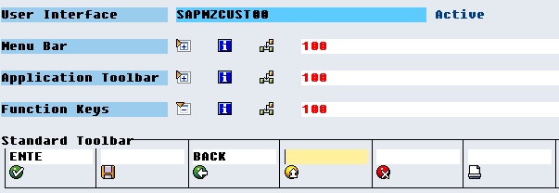
Example 1 - Change
Specify the Enter Function at GUI Status

Slide 86
Check Enter Function
Screen 100 : PAI
MODULE user_command_0100 INPUT.
CASE ok_code.
WHEN ‘BACK’.
LEAVE PROGRAM.
WHEN ‘ENTE’.
SELECT SINGLE * FROM customers
WHERE id = customers-id.
LEAVE TO SCREEN 200.
ENDCASE.
ENDMODULE.

Slide 87
Clear OK_CODE at PBO
Screen 100 : Flow Logic
PROCESS BEFORE OUTPUT.
MODULE STATUS_0100.
MODULE clear_ok_code.
PROCESS AFTER INPUT.
MODULE USER_COMMAND_0100.

Slide 88
Clear OK_CODE at PBO
Screen 100 : PBO
MODULE status_0100 OUTPUT.
SET PF-STATUS ‘0100’.
SET TITLEBAR ‘0100’.
ENDMODULE.
MODULE clear_ok_code OUTPUT.
CLEAR ok_code.
ENDMODULE.

Slide 89
Checking User Input
Maintain Customers Data
Check Input Data Manually
Screen 100 : PAI
MODULE user_command_0100 INPUT.
...
WHEN SPACE.
SELECT SINGLE * FROM customers WHERE id = customers-id.
IF sy-subrc <> 0.
MESSAGE S000(38) WITH ‘Customers data not found’.
LEAVE TO SCREEN 100.
ELSE.
LEAVE TO SCREEN 200.
ENDIF.
ENDCASE.
ENDMODULE.

Slide 90
Checking User Input
Maintain Customers Data
Check Input Data Using Field Command
Screen 100 : Flow Logic (PAI)
PROCESS AFTER INPUT.
FIELD customers-id MODULE user_command_0100.
Screen 100 : PAI
MODULE user_command_0100 INPUT.
...
WHEN SPACE.
SELECT SINGLE * FROM customers WHERE id = customers-id.
IF sy-subrc <> 0.
MESSAGE E000(38) WITH ‘Customers data not found’.
ELSE.
LEAVE TO SCREEN 200.
ENDIF.
ENDCASE.
ENDMODULE.

Slide 91
Field Input Checking
If you want to check input values in the module pool and start dialog in the event of a negative result,you use the FIELD statement with the addition MODULE.
If the module results in an error(E) or warning(W) message,the screen is redisplayed without processing the PBO modules.The message text is displayed and only the field being checked by this module becomes ready for input again

Slide 92
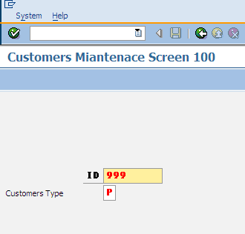
Field Statement With More Than 1 Field
Screen 100 : Flow Logic (PAI)
PROCESS AFTER INPUT.
CHAIN.
FIELD: customers-id,customers-custtype
MODULE user_command_0100.
ENDCHAIN.
PROCESS AFTER INPUT.
CHAIN.
FIELD customers-id MODULE user_command_0100.
FIELD customers-custtype MODULE user_command_0100.
ENDCHAIN.

Slide 93
Field Statement and Data Transport
PROCESS AFTER INPUT.
MODULE a.
FILED f1 MODULE b.
FILED f2 MODULE c.
MODULE d.
Transfer f3,f4
Call module a
Transfer f1
Call module b
Transfer f2
Call module c
Call module d
Screen 100
f1
f2
f3
f4

Slide 94
Required Field

Slide 95
EXIT Command

Slide 96
EXIT Command
When user chooses a function with type E,the screen flow logic jumps directly to the following statement
MODULE <module> AT EXIT-COMMAND
No other screen fields are transported to the program except OK Code field

Slide 97
EXIT Command
Screen 100 : Flow Logic
PROCESS BEFORE OUTPUT.
MODULE STATUS_0100.
PROCESS AFTER INPUT.
MODULE exit AT EXIT-COMMAND.
MODULE USER_COMMAND_0100.
Screen 100 : PAI
MODULE exit INPUT.
CASE ok_code.
WHEN ‘EXIT’.
LEAVE PROGRAM.
ENDCASE.
ENDMODULE.
LEAVE PROGRAM.

Slide 98
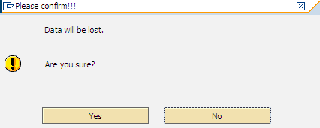
Function Module (POPUP_TO_CONFIRM_LOSS_OF_DATA)

Slide 99
Function Module (POPUP_TO_CONFIRM_LOSS_OF_DATA)
TOP INCLUDE
...
DATA ans.
Screen 100 : PAI
MODULE exit INPUT.
CALL FUNCTION ‘POPUP_TO_CONFIRM_LOSS_OF_DATA’
EXPORTING
textline1 = ‘Are you sure?’
titel = ‘Please Confirm!!!’
IMPORTING
answer = ans.
IF ans = ‘J’. “J = Ja in German= Yes in English
LEAVE PROGRAM.
ELSE.
ENDIF.
ENDMODULE.

Slide 100
Process on Help-Request (POH)
To display field help documentation, you must code the following screen in POH event :
If there is screen-specific data element documentation for the field <f>, you can display it by specifying its number <num>.
The number <num> can be a literal or a variable. The variable must be declared and filled in the corresponding ABAP program.
Note, the FIELD statement does not transfer the contents of the screen field <f> to the ABAP program in the PROCESS ON HELP-REQUEST event. It just shows help documentation. That's it.
PROCESS ON HELP-REQUEST.
FIELD <f> [MODULE <num>] WITH <num>.

Slide 101
Process on Value (POV)
To define Possible values for a field on screen, you need to defined following in POV event of screen flow logic:
For Possible values, within module defined above, you should use the general function module HELP_VALUES_GET_WITH_TABLE to get possible values from ABAP Dictionary.
There are some other functions that can also be used for input help : F4IF_FIELD_VALUE_REQUEST
PROCESS ON VALUE-REQUEST.
FIELD <f> MODULE <module-name>.

Slide 102
Function Module (F4IF_FIELD_VALUE_REQUEST)
CALL FUNCTION 'F4IF_INT_TABLE_VALUE_REQUEST'
EXPORTING
RETFIELD = 'CONNID'
DYNPPROG = PROGNAME
DYNPNR = DYNNUM
DYNPROFIELD = 'CONNECTION'
VALUE_ORG = 'S'
TABLES
VALUE_TAB = VALUES_TAB.

Slide 103
ABAP Training Day 4

Slide 104
Agenda
Data Transfer
Call Transaction
Session Method
BAPI
Enhancement
User Exit
Customer Exit
BADI
Explicit and Implicit Enchancement

Slide 105
Data Transfer
Data is transferred from an external system into the SAP R/3 System. You can use data transfer when you:
Transfer data from an external system into an R/3 System as it is installed.
Transfer data regularly from an external system into an R/3 System. Example: If data for some departments in your company is input using a system other than the R/3 System, you can still integrate this data in the R/3 System. To do this, you export the data from the external system and use a data transfer method to import it into the R/3 System.

Slide 106
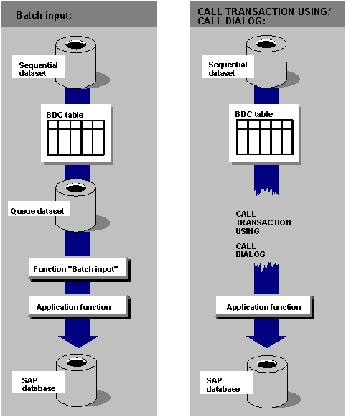
Data Transfer Methods

Slide 107
Batch Input
In this method an ABAP/4 program reads the external data to the SAP System and stores in a batch input session.
After creating the session, you can run the session to execute the SAP transaction in it.
This method uses the function modules BDC_ OPEN, BDC_INSERT and BDC_CLOSE
Batch Input Session can be process in 3 ways
In the foreground
In the background
During processing, with error display

Slide 108
Batch Input
You should process batch input sessions in the foreground or using the error display if you want to test the data transfer.
If you want to execute the data transfer or test its performance, you should process the sessions in the background.
Points to note about Classical Batch Input method
Asynchronous processing
Transfer data for multiple transactions.
Synchronous database update.
A batch input process log is generated for each session.
Session cannot be generated in parallel.

Slide 109
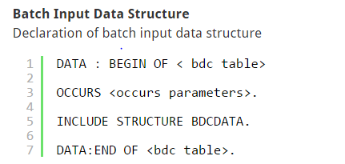
Batch Input

Slide 110
CALL TRANSACTION
In this method ABAP/4 program uses CALL TRANSACTION USING statement to run an SAP transaction.
Entire batch input process takes place online in the program
Points to Note:
Faster processing of data
Synchronous processing
Transfer data for a single transaction.
No batch input processing log is generated.

Slide 111
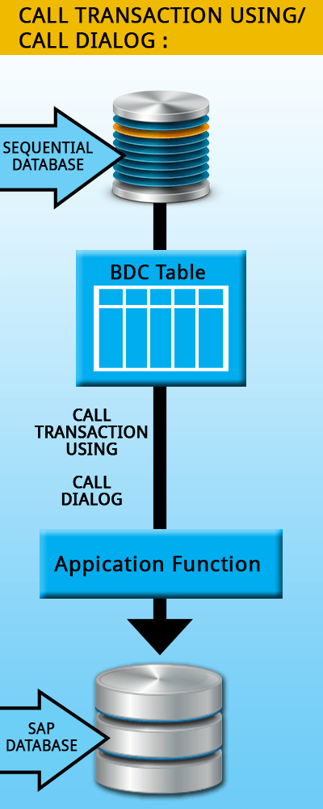
CALL TRANSACTION

Slide 112
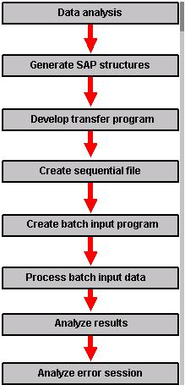
Steps to develop Batch Input
Notes:
You will typically observe the following sequence of steps to develop Batch Input for your organization
Analysis of the legacy data. Determine how the data to be transferred is to be mapped in to the SAP Structure. Also take note of necessary data type or data length conversions.
Generate SAP data structures for using in export programs.
Export the data in to a sequential file. Note that character format is required by predefined SAP batch input programs.
If the SAP supplied BDC programs are not used, code your own batch input program. Choose an appropriate batch input method according to the situation.
Process the data and add it to the SAP System.
Analyze the process log. For the CALL TRANSACTION method, where no proper log is created, use the messages collected by your program.
From the results of the process analysis, correct and reprocess the erroneous data.

Slide 113
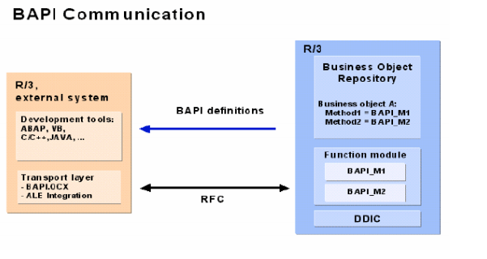
BAPI
BAPIs are defined in the Business Object Repository (BOR) as methods of SAP Business Objects or SAP Interface Types and are implemented as function modules. The separation of a BAPI definition from its actual implementation enables you to access a BAPI in two ways:
Call the BAPI in the BOR through object-oriented method calls
RFC calls to the function module on which the BAPI is based
Notes:
You will typically observe the following sequence of steps to develop Batch Input for your organization
Analysis of the legacy data. Determine how the data to be transferred is to be mapped in to the SAP Structure. Also take note of necessary data type or data length conversions.
Generate SAP data structures for using in export programs.
Export the data in to a sequential file. Note that character format is required by predefined SAP batch input programs.
If the SAP supplied BDC programs are not used, code your own batch input program. Choose an appropriate batch input method according to the situation.
Process the data and add it to the SAP System.
Analyze the process log. For the CALL TRANSACTION method, where no proper log is created, use the messages collected by your program.
From the results of the process analysis, correct and reprocess the erroneous data.

Slide 114
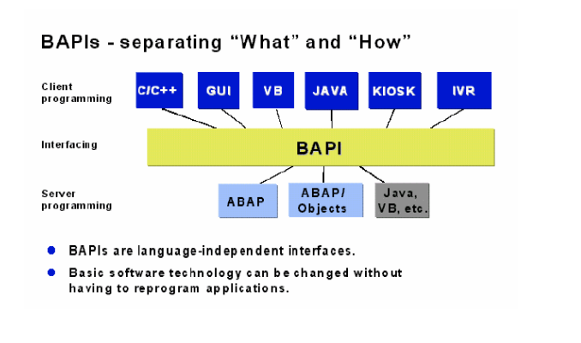
BAPI
Notes:
You will typically observe the following sequence of steps to develop Batch Input for your organization
Analysis of the legacy data. Determine how the data to be transferred is to be mapped in to the SAP Structure. Also take note of necessary data type or data length conversions.
Generate SAP data structures for using in export programs.
Export the data in to a sequential file. Note that character format is required by predefined SAP batch input programs.
If the SAP supplied BDC programs are not used, code your own batch input program. Choose an appropriate batch input method according to the situation.
Process the data and add it to the SAP System.
Analyze the process log. For the CALL TRANSACTION method, where no proper log is created, use the messages collected by your program.
From the results of the process analysis, correct and reprocess the erroneous data.

Slide 115
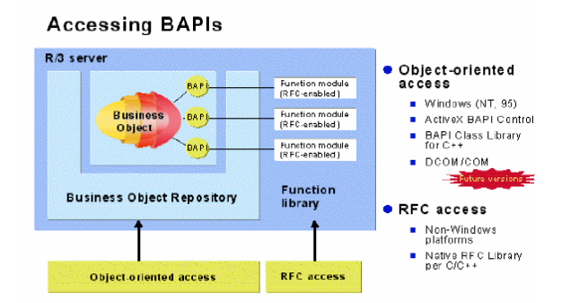
BAPI
Notes:
You will typically observe the following sequence of steps to develop Batch Input for your organization
Analysis of the legacy data. Determine how the data to be transferred is to be mapped in to the SAP Structure. Also take note of necessary data type or data length conversions.
Generate SAP data structures for using in export programs.
Export the data in to a sequential file. Note that character format is required by predefined SAP batch input programs.
If the SAP supplied BDC programs are not used, code your own batch input program. Choose an appropriate batch input method according to the situation.
Process the data and add it to the SAP System.
Analyze the process log. For the CALL TRANSACTION method, where no proper log is created, use the messages collected by your program.
From the results of the process analysis, correct and reprocess the erroneous data.

Slide 116
BAPI
Frequently used BAPI:
Sales and Distribution
Customer Material Info - BAPI_CUSTMATINFO_GETDETAILM
Sales order - BAPI_SALESORDER_GETLIST
Sales order - BAPI_SALESORDER_GETSTATUS
Material Management
Purchase Req Item - BAPI_REQUIREMENT_GET_LIST
Purchase order - BAPI_PO_GETDETAIL
Purchase order - BAPI_PO_GETITEMS
Notes:
You will typically observe the following sequence of steps to develop Batch Input for your organization
Analysis of the legacy data. Determine how the data to be transferred is to be mapped in to the SAP Structure. Also take note of necessary data type or data length conversions.
Generate SAP data structures for using in export programs.
Export the data in to a sequential file. Note that character format is required by predefined SAP batch input programs.
If the SAP supplied BDC programs are not used, code your own batch input program. Choose an appropriate batch input method according to the situation.
Process the data and add it to the SAP System.
Analyze the process log. For the CALL TRANSACTION method, where no proper log is created, use the messages collected by your program.
From the results of the process analysis, correct and reprocess the erroneous data.

Slide 117
Enhancement
An enhancement is any product change or upgrade that increases software capabilities beyond original client specifications. Enhancements allows you to add your own functionality to SAP's standard business applications without having to modify the original applications. To modify the standard SAP behaviour as per customer requirements, we can use enhancement framework.
Technologies available as part of Enhancement
Source Code enhancement
Function Group enhancement
Class enhancement
Kernel-BADI enhancement

Slide 118
Basic Concepts of Enhancement
The basic concepts in the Enhancement Framework are:
Enhancement options: positions in repository objects where you can make enhancements. Enhancement options can be explicit and implicit.
Enhancement spots: containers for explicit enhancement options.
Enhancement implementation elements: these contain the actual enhancement, for example, the source code to be added.
Enhancement implementations: containers for both enhancement implementation elements of both implicit and explicit enhancement options.

Slide 119
Source Code enhancement
Whenever enhancement needs to be incorporated directly into the ABAP source code, this technology shall be provided. Implementing this technology is also called as Source Code Plug-In. There are two types of Source Code enhancements possible.
Implicit enhancement option
Explicit enhancement option
In order to implement any of these Source code enhancements, you need to be in the ‘Change Enhancement mode’ (the spiral icon available in the editor).

Slide 120
Implicit Enhancement Option
Throughout the ABAP system, enhancement options are automatically available at certain pre-defined places. Some of the implicit options are:
At the end of all the programs (Includes, Reports, Function pool, Module pool, etc.), after the last statement
At the beginning and end of all FORM subroutines
At the end of all Function Modules
At the end of all visibility areas (public, protected and private) of local class To view all the implicit options available in a source code, choose ‘Edit -> Enhancement Operations -> Show Implicit Enhancement Options’ from the editor.
To view all the implicit options available in a source code, choose ‘Edit -> Enhancement Operations -> Show Implicit Enhancement Options’ from the editor.

Slide 121
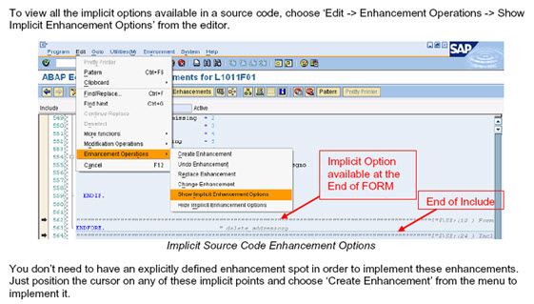
Implicit Enhancement Option

Slide 122
Explicit Enhancement Option
These are predefined enhancement sections, usually defined by SAP. Explicit Enhancements are stored in Enhancement Spots.
Explicit Enhancements are pretty easy to implement; in the ABAP editor, get into the Enhancement Mode by clicking the spiral button. Then, right click into the enhancement point you plan to implement and select Enhancement Implementation->Create. You will be asked a name and a description and after this you can simply add your code.
There are two types of Explicit Enhancement options available.
Enhancement Point
Enhancement Section

Slide 123
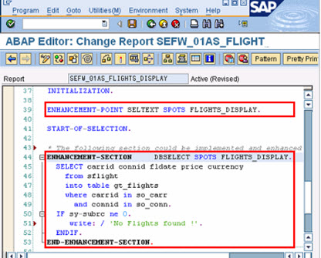
Explicit Enhancement Option

Slide 124
Function Group Enhancement
All application function modules can be enhanced by adding parameters to the standard function module interface. These parameters must be ‘optional’ in nature, since adding a mandatory parameter will require all calls to be changed. Additionally any function module that is part of the Central Basis can not be enhanced (for example: function module ‘POPUP_TO_CONFIRM’). From the menu, choose ‘Function module -> Enhance interface’ to add optional parameters to a function module.

Slide 125
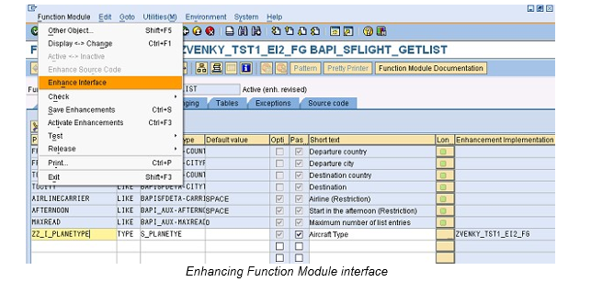
Function Group Enhancement

Slide 126
Class Enhancement
The global Classes and Interfaces can be enhanced as follows:
Adding optional parameters to existing Methods
Adding new Methods to the global Class / Interface
Adding Pre-exit, Post-exit or Overwrite-exit to an existing Method
The Pre and Post exits get executed before and after invoking the respective method. These are achieved by an automatically generated local class. All methods are stored as part of this local class.
Choose menu option ‘Class -> Enhance’ to add new methods or parameters. Choose menu option ‘Edit -> Enhancement operations’ to add or delete the Pre/Post/Overwrite exit methods.

Slide 127
Kernal – BADI Enhancement
The old classic-BADI’s are implemented purely at the ABAP Workbench level; that is, both the definition and implementation are realized as workbench repository objects (global classes and interfaces). The new Kernel-BADI takes it to the ABAP language level. Because of this, the new Kernel-BADI’s are much faster compared to the old classic-BADI’s.
There are two new ABAP statements available now to support the Kernel-BADI’s, namely GET BADI and CALL BADI.
Example:
data bd_hdl type ref to badi_name.
GET BADI bd_hdl filters filt_1 = ‘VALUE’.
CALL BADI bd_hdl->method
exporting param_1 = 10.

Slide 128
Kernal – BADI Enhancement
The old classic-BADI used to mix both implementation selection and method call in the same CALL METHOD statement. The implementations could only be chosen at run-time because of the above reason and due to the fact that the BADI handle could only be gotten from another method call by passing the BADI name.
In the new Kernel-BADI, the active BADI implementations are included into the load of BADI handle at compile time and the filter criterion are expanded as IF statements.
Some of the other new features of Kernel-BADI’s are,
Improved Filters with complex filter condition editor
Stateful BADI support and Context based lifetime control
Possibility to inherit the implementations
Switchable using Switch Framework

Slide 129
User Exits
These are implemented in the form of subroutines and hence are also known as FORM EXITs. The user exits are generally collected in includes and attached to the standard program by the SAP.
User exits are a type of system enhancement that was originally developed for the R/3 SD (Sales and distribution) module. User-exits are empty subroutines that SAP Developers have provided for you. You can fill them with your own source code.
Technically this is a modification. All User exits start with the word USEREXIT_... FORM USEREXIT_XXXX.... INCLUDE ZZUSEREXIT....... ENDFORM.

Slide 130
Customer Exit
SAP creates customer exits for specific programs, screens, and menus within standard applications. These exits do not contain any functionality. Instead, the customer exits act as hooks. You can hang your own add-on functionality onto these hooks. Customer exits are nothing but a include in customer name space will be provided in the function module which starts with CALL CUSTOMER. You can fill them with your own source code. Technically this is an enhancement. User exits generally refer to SD module while customer exits refer to all modules like MM, SD, PP, FICO etc.
Advantage: - They do not affect standard SAP source code - They do not affect software updates
Disadvantage: - Customer exits are not available for all programs and screens found in the SAP System. You can only use customer exits if they already exist in the SAP System.

Slide 131
Types of Customer Exit
Function Module exit
The exit is implemented as a call to a function module. The code for the function module is written by the developer. You are not writing the code directly in the function module, but in the include that is implemented in the function module.
Screen exits
Allow customer to add fields to a screen via a sub screen in an SAP program. The sub screen is called within the standard screen's flow logic.
Menu Exit
Menu exits allow you to add your own functionality to menus. Menu exits are implemented by SAP and are reserved menu entries in the GUI interface. The developer can add his/her own text and logic for the menu. Function codes for menu exits all start with "+".

Slide 132
ABAP Training Day 5

Slide 133
Agenda
Forms
Smartforms
Scripts
Performance Tuning
Break Points
Runtime Analysis
SQL Trace
Debugging
Function Module
Subroutime

Slide 134
SAP Forms : Overview
SAP first form technology was the SAPscript technology.
In release 4.6, SAP introduced Smart Forms, which eased the creation of form output by allowing modelling of logic and output using graphical tools.
In release 6.40, SAP introduced Adobe forms, where the graphical editor was much more easy-to-use and had many more functionalities, and output was rendered exactly the same as what was designed in the editor (PDF).

Slide 135
SAPscript
SAP Script is the SAP System's own text-processing system.
SAP Script is integrated text management system of the SAP R/3 system.
The TCode (Transaction Code) is SE71.
It is used to print preformatted text in preformatted forms.
Unlike reports , the text can be aligned, different fonts can be used. Company Logo can be printed.

Slide 136
Components of SAPscript Layout
Header
This part of the layout set consists of both administrative data and basic (default) settings for the various other components of the layout set like First page, Default paragraph for Layout set etc.,
Pages
At least one logical page must be defined for every layout set. (Otherwise it is not possible to format the texts ) A page is defined by assigning a name and specifying attributes.
Windows
At least one logical window must be defined for every page. (Otherwise it is not possible to format the texts) Window definition involves a list of window names and corresponding window types. A MAIN window is displayed automatically.

Slide 137
Components of SAPscript Layout
Page Windows
A page window is defined by allocating a logical window to a logical page and specifying the position and size of the window.
Paragraph Formats
A paragraph contains all the information needed to format a paragraph of text and font. Tabs are important for paragraphs. Specifying the list of tabs is the way to create columns for outputting line items of a document.
Character Formats
This is used to override paragraph settings for specific words in a Paragraph.

Slide 138
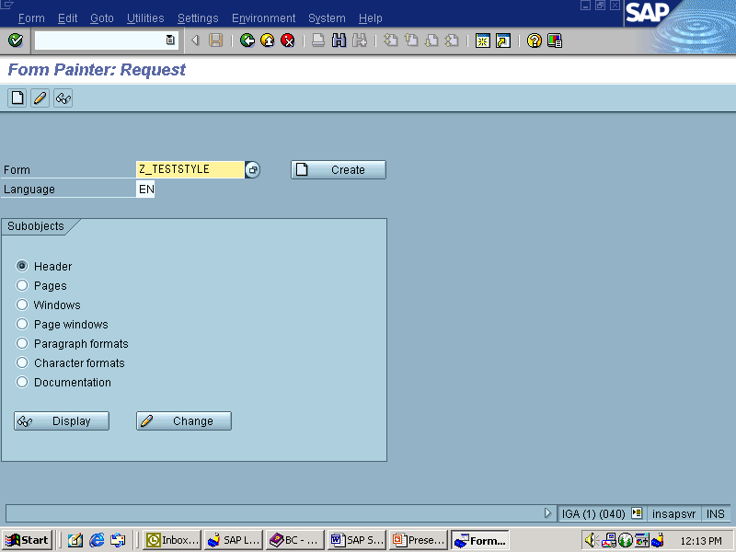
Steps to Create Layout Set – Step 1
Go to SE71. This takes you to the Form .Enter name for the Layout / Form in the text box given.The screen as shown below.

Slide 139
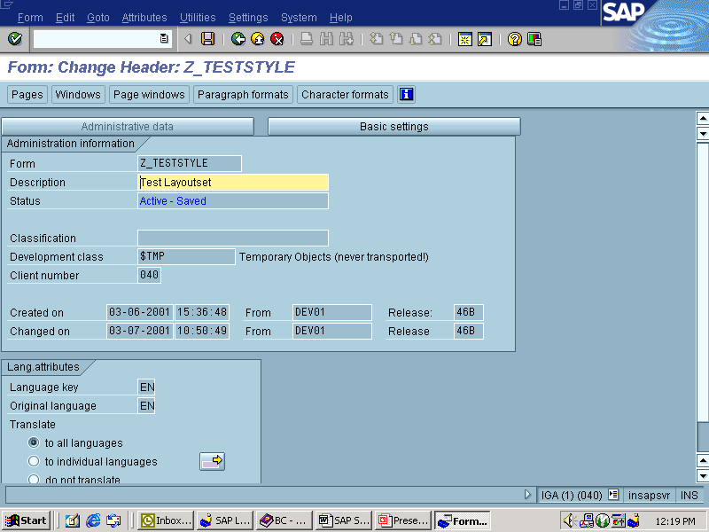
Steps to Create Layout Set – Step 2
Enter the description for the layout set.

Slide 140
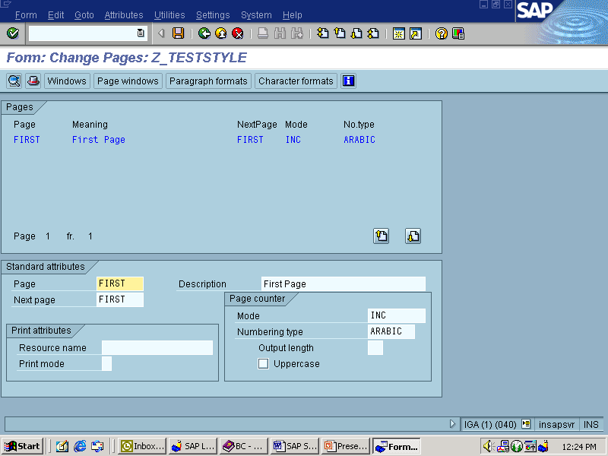
Steps to Create Layout Set – Step 3
Create Page and specify the Standard attributes.

Slide 141
Steps to Create Layout Set – Step 4
The above screen takes to the Pages screen of the Form. After Pages, you have to create Windows needed for the Page. Go to Windows button on the toolbar. MAIN Window is created given by the system itself. The Window can be of type VAR or CONST except for MAIN.

Slide 142
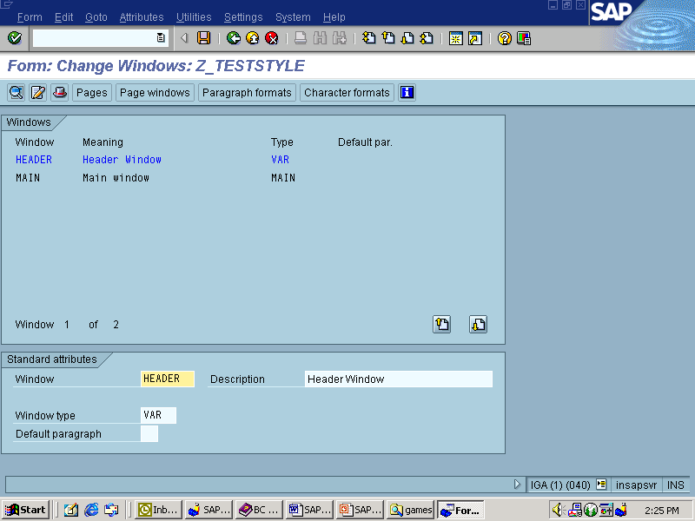
Steps to Create Layout Set – Step 5
Next step is to create Windows on the Page .

Slide 143
Steps to Create Layout Set – Step 6
To Create Windows go to Edit -> Create Element of Menu bar.Using this option you can create as many windows as needed for the page.By default the Window created will have window type as VAR.For Windows to be Constant, you can name them as CONST.
Next step after creating Windows is to “Create Page Windows”.Click “Page Windows” on the Application toolbar. Choose the Windows needed for that page using Edit -> Create Element. Enter the margins for the Page Windows created in the Standard attributes.

Slide 144
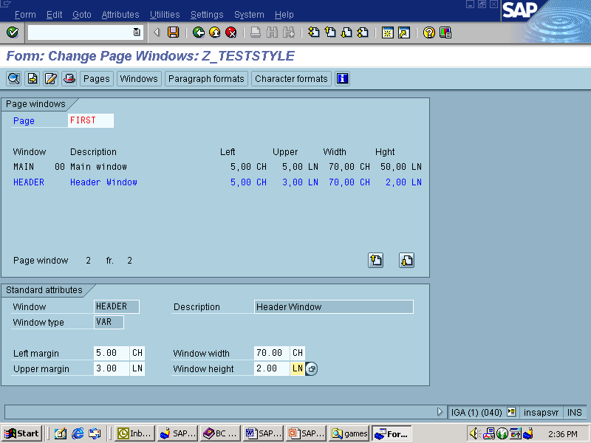
Steps to Create Layout Set – Step 6

Slide 145
Steps to Create Layout Set – Step 7
Go to Paragraph Formats in the Application toolbar.
Name the Paragraph Format and enter the description .Specify the Font family and size .If needed ,specify the tab positions. Tabs are columns created for outputting line items of a document.

Slide 146
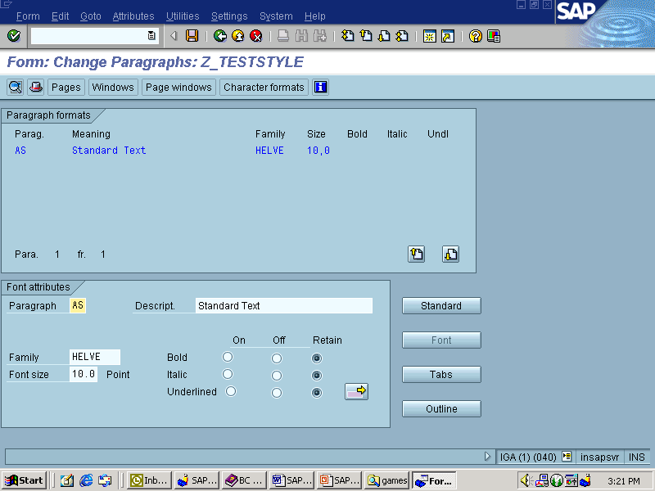
Steps to Create Layout Set – Step 7

Slide 147
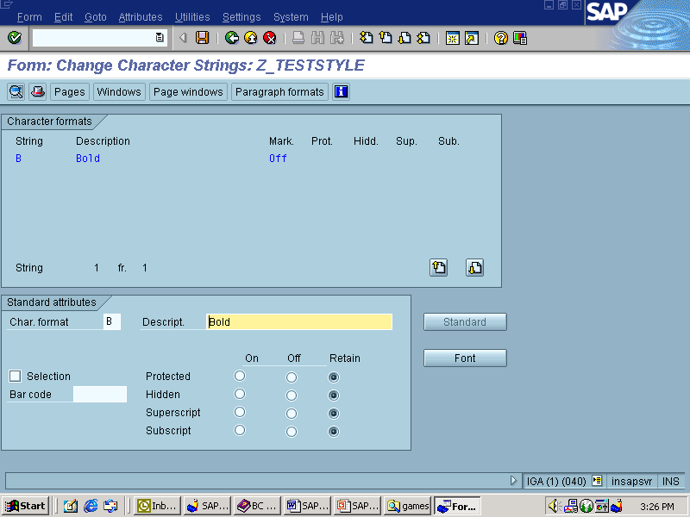
Steps to Create Layout Set – Step 8
Next step is to create “Character Formats”. This is used to override the paragraph settings for specific words.

Slide 148
Steps to Create Layout Set – Step 9
Go to Text Elements (F9) in the Application toolbar of the selected page window.
The text elements are assigned to the active window. You can create several text elements in a window.
The text elements are called from print program, through function modules and outputted in the respective window.

Slide 149
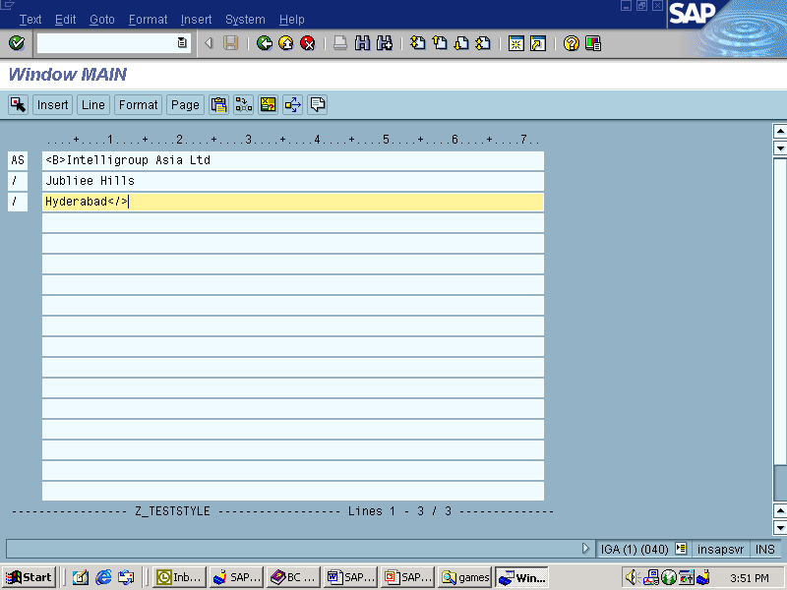
Steps to Create Layout Set – Step 9

Slide 150
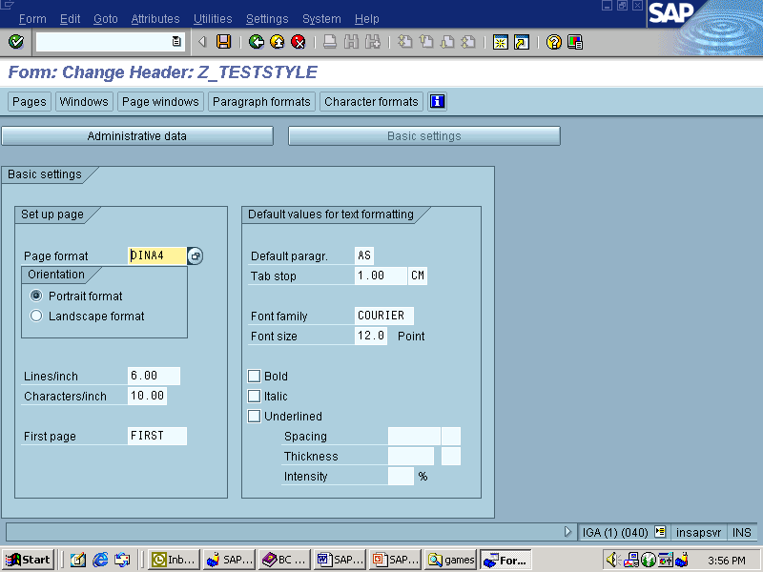
Steps to Create Layout Set – Step 10
Next step is to save the Layout. Go to Form -> Save. While saving the Form ,it asks for the Default paragraph and page in Header details of Basic Settings. You need to specify the default paragraph and page in this page.

Slide 151
Steps to Create Layout Set – Step 11
The form gets saved after entering the above details. Save the form as a local object. Next step is to activate the Layout set. After activating the form, a driver program or print program has to written in SE38. The print program has to be written using Open, Write and Close function modules.
Function Modules
Open Form
Close Form
Control Form
Write Form
Start Form
End Form

Slide 152
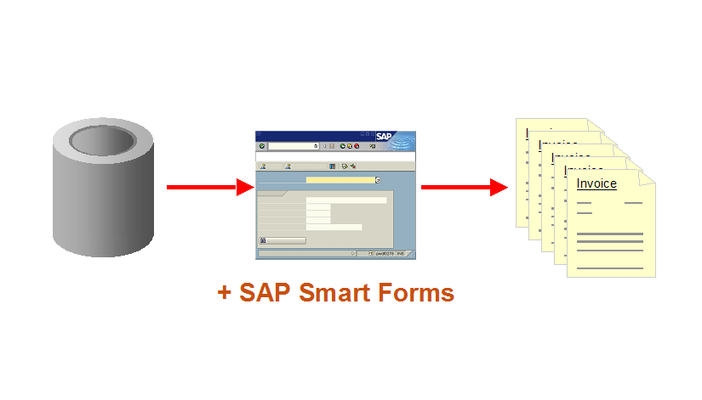
SAP Smart Forms
Smart form is a GUI Tool which is used to design the business legal documents such as Delivery note, Purchase order, Invoice etc.
The transaction code is SMARTFORMS.
Smartforms are client independent objects.
Smartforms are advanced version of SAP Scripts.
It is a GUI tool and it is user friendly.

Slide 153
SAP Smart Forms - Architecture

Slide 154
SAP Smart Forms GUI

Slide 155
SAP Smart Forms Components
There are two main nodes in Smartforms.
Global Settings
Form Attribute
Form Interface
Global Defination
Pages and Windows

Slide 156
SAP Smart Forms – Global Settings
It is used to provide the basic settings for the smartform.
Form Attribute
It specifies the general attributes like who created, Date, time, package, translate options, default smartstyle, Page format (DINA4/DINA5).
Form Interface
It acts as a mediator between a driver program and a smart form.
The main functionality of form interface is, it will import the parameters which are exported by driver program.
Global Defination
It will contain the variables to be used within the smart form.
We can define variables, user defined data types, field symbols, initialization code,Subroutine, currency/quantity fields.

Slide 157
SAP Smart Forms – Pages & Windows
This will contain all the pages and the windows, which are used in the smartform.
Page
It is used to define the layout of a smartform.
We can have different pages with different layouts.
Window
it is used to display information at a particular place on a page.
Graphic
It is used to display logos or images on the smartforms.
Address –
It is used to display the address of customer or vendor or employee, organization address , workplace address etc.
Just provide address no, it will automatically display the address as per the country formats.

Slide 158
SAP Smart Forms – Nodes under the Window
Text
It is used to display the information or text in a window.
Table
It is used to display the information in the form of table.
When ever we create table by default HEADER, MAIN AREA, FOOTER will be displayed.
The main functionality of a table is, it expands automatically depending on the internal table data.
Template
Template is also like a table which does not expand. That means it will have fixed number of rows and columns.
Program Lines
It is used to write some lines of abap code.

Slide 159
SAP Smart Forms – Types of Window
Main Window
For continuous output.
Secondary Window
For output with a fixed length.
Final Window
Special type of secondary window for outputting the information that is not known until the end of form processing.
Copies Window
Special type of secondary window for marking pages as copy or original.

Slide 160
Steps to Create Smart Form – Step 1
Go to transaction ‘SMARTFORMS’
Enter the name of form and click on Create

Slide 161
Steps to Create Smart Form – Step 2
Enter a short description for the form.

Slide 162
Steps to Create Smart Form – Step 3
In this example, we will print a simple text using our form. To create a text, expand “Pages and Windows”-> New Page. Select Main Window and Right click on that. Select Create à Text

Slide 163
Steps to Create Smart Form – Step 4
Give a name to the text and short description.
Also enter the text you want to see on the form.

Slide 164
Steps to Create Smart Form – Step 5
SAVE and Activate the Smart form.
To know the function module that is generated upon activation of this smart form, click on Environment -> Function module name.

Slide 165
Steps to Create Smart Form – Step 6
Test the smart form by clicking on Test. You would be navigated to the function builder with the function module defaulting to the one that is generated earlier.
Click on Execute

Slide 166
Steps to Create Smart Form – Step 7
Since we do not have any parameters to pass on, click on Execute.

Slide 167
Steps to Create Smart Form – Step 7

Slide 168
For All Entries
The for all entries creates a where clause, where all the entries in the driver table are combined with OR.
If the number of entries in the driver table is larger than rsdb/max_blocking_factor, several similar SQL statements are executed to limit the length of the WHERE clause.
Pros | Cons
Large Amount of Data Mixing processing and reading of data Fast Internal processing of data Fast | Difficult to program/understand Memory could be critical (Use FREE or PACKAG size)
Removing duplicates from the driver table
Sorting the driver table
If possible, convert the data in the driver table to ranges so a BETWEEN statement is used instead of and OR statement: FOR ALL ENTRIES IN i_tab WHERE mykey >= i_tab-low and mykey <= i_tab-high.

Slide 169
Nested Selects
Pros | Cons
Small amount of data Mixing processing and reading of data Easy to code - and understand | Large amount of data when mixed processing isn’t needed Performance killer no. 1

Slide 170
Select Using Joins
Pros | Cons
Very large amount of data Similar to Nested selects - when the accesses are planned by the programmer In some cases the fastest Not so memory critical | Very difficult to program/understand Mixing processing and reading of data not possible

Slide 171
Use the selection criteria
Don’ts | Do’s
SELECT * FROM SBOOK. CHECK: SBOOK-CARRID = 'LH‘ AND SBOOK-CONNID = '0400'. ENDSELECT. | SELECT * FROM SBOOK WHERE CARRID = 'LH‘ AND CONNID = '0400'. ENDSELECT.

Slide 172
Use the aggregated functions
Don’ts | Do’s
C4A = ‘000’. SELECT * FROM T100 WHERE SPRSL = ‘D’ AND ARBGB = ‘00‘. CHECK : T100-MSGNR > C4A. C4A = T100-MSGNR. ENDSELECT. | SELECT MAX( MSGNR ) FROM T100 INTO C4A WHERE SPRSL = 'D‘ AND ARBGB = '00'.

Slide 173
Select with view
Don’ts | Do’s
SELECT * FROM DD01L WHERE DOMNAME LIKE 'CHAR%‘ AND AS4LOCAL = 'A'. SELECT SINGLE * FROM DD01T WHERE DOMNAME = DD01L-DOMNAME AND AS4LOCAL = 'A' AND AS4VERS = DD01L-AS4VERS AND DDLANGUAGE = SY-LANGU. ENDSELECT. | SELECT * FROM DD01V WHERE DOMNAME LIKE 'CHAR%‘ AND DDLANGUAGE = SY-LANGU. ENDSELECT.

Slide 174
Select with index support
Don’ts | Do’s
SELECT * FROM T100 WHERE ARBGB = '00' AND MSGNR = '999'. ENDSELECT. | SELECT * FROM T002. SELECT * FROM T100 WHERE SPRSL = T002-SPRAS AND ARBGB = '00‘ AND MSGNR = '999'. ENDSELECT. ENDSELECT.

Slide 175
Select … Into table
Don’ts | Do’s
REFRESH X006. SELECT * FROM T006 INTO X006. APPEND X006. ENDSELECT | SELECT * FROM T006 INTO TABLE X006.

Slide 176
Select with selection list
Don’ts | Do’s
SELECT * FROM DD01L WHERE DOMNAME LIKE 'CHAR%‘ AND AS4LOCAL = 'A'. ENDSELECT | SELECT DOMNAME FROM DD01L INTO DD01L-DOMNAME WHERE DOMNAME LIKE 'CHAR%‘ AND AS4LOCAL = 'A'. ENDSELECT

Slide 177
Key access to multiple lines
Don’ts | Do’s
LOOP AT TAB. CHECK TAB-K = KVAL. " ... ENDLOOP. | LOOP AT TAB WHERE K = KVAL. " ... ENDLOOP.

Slide 178
Copying internal tables
Don’ts | Do’s
REFRESH TAB_DEST. LOOP AT TAB_SRC INTO TAB_DEST. APPEND TAB_DEST. ENDLOOP. “Appending Two Tables LOOP AT TAB_SRC. APPEND TAB_SRC TO TAB_DEST. ENDLOOP | TAB_DEST[] = TAB_SRC[]. APPEND LINES OF TAB_SRC TO TAB_DEST.

Slide 179
Deleting a sequence of lines
Don’ts | Do’s
DO 101 TIMES. DELETE TAB_DEST INDEX 450. ENDDO. LOOP AT TAB_DEST WHERE K = KVAL. DELETE TAB_DEST. ENDLOOP | DELETE TAB_DEST FROM 450 TO 550. DELETE TAB_DEST WHERE K = KVAL.

Slide 180
Linear search vs. binary
Don’ts | Do’s
READ TABLE TAB WITH KEY K = 'X'. | READ TABLE TAB WITH KEY K = 'X' BINARY SEARCH.

Slide 181
Breakpoint
A breakpoint is an area in an ABAP program where the execution halts and turns on the debugging mode. The control is then transferred to the ABAP debugger, which further controls the execution of the program.
Breakpoints are classified namely as session breakpoints, debugger breakpoints and static breakpoints. They can be active or passive at runtime and can be set for all users, specific users or based on a checkpoint.
Breakpoints help in the debugging process of ABAP objects, and aid in evaluating only the concerned sections of ABAP code, whiles skipping the rest of the areas.

Slide 182
Debugging
Debugging is the process of analysing the flow of a program to locate and reduce defects or bugs. Unlike other programming languages, debugging in SAP involves analysing different objects. Thus, different techniques are used to debug different types of objects.
In SAP, the debugging process is applied with the help of ABAP Debugger, a SAP programming tool that is capable of analysing an ABAP program or object, by line or section, and can even change object values at runtime.
Types of Debugger
Classic ABAP Debugger (for Release up to 6.40)
New ABAP Debugger (for all 6.40 and later)

Slide 183
Debugging method for a SAP Object
By typing the command "/h" in the command field, which executes the program in debugging mode
With the help of breakpoints, which may be kept before or during the debugging mode
By selecting debugging when the execution program mode appears
From menu path system-> utilities-> debug ABAP

Slide 184
Debugging method for different SAP Object
For ABAP program and function modules, debugging may be applied by typing "/h" in the command field, using breakpoints or choosing the execution mode for debugging.
For ABAP SAPscripts, smart forms and Adobe forms, debugging options are provided separately for driver programs, in addition to these objects.
For server or remote access, remote access debugging is provided through predefined or customized usernames, which are used for connecting to a server or remote access.

Slide 185
New ABAP Debugger working
Unlike the classic ABAP debugger, the New ABAP Debugger is processed in its own external mode (known as the debugger) while the analysed object (known as the debugger) is run in a second external mode.
It is capable of analysing programs executed in an ABAP processor unit, such as programs that call conversion exits.
It has a flexible interface that a user may design according to requirements.
It has the ability to accommodate more than eight desktop views, as well as the ability to arrange different tools for analysing the structure and data passed in the ABAP program or object.

Slide 186
SQL Trace
The SQL Trace part of the Performance Trace tool allows you to see how the OPEN SQL statements that you use in ABAP programs are converted to standard SQL statements and the parameters with which the embedded SQL statements are passed to the database system.
From the time you turn on the trace function to the time you turn it off again, all database activity occurring either for a specific user or for an entire system is recorded. The results of the SQL statement, like return code, number of entries retrieved, inserted, or deleted by the database are recorded in the SQL Trace file.

Slide 187
SQL Trace – How it is useful?
From the Recorded SQL trace, we can deduce :
which SQL statements your application carries out
which values the system uses for specific database accesses and changes
how the system translates ABAP OPEN SQL commands (such as SELECT) into standard SQL commands
where your application positions COMMIT statements
where your application makes repeated database accesses
what database accesses or changes occur in the update section of your application

Slide 188
Runtime Analysis
With the Runtime Analysis, you can analyse the performance of ABAP programming units that you have created in the ABAP Workbench. Included in this are reports and subprograms, functions modules, modules, for example. It saves its results in performance data files, which you can display as lists. You can use these results to identify runtime-intensive statements, to combine table accesses, and show the hierarchy of program calls. From the results of the Runtime Analysis, you can identify:
Excessive or unnecessary use of modularization units
User-specific functions that could be replaced with ABAP statements
Inefficient or redundant database access.

Slide 189
Procedures
Procedures contain a set of statements, and are called from other ABAP programs.
You define procedures in ABAP programs. When the program is generated, they remain as standalone modules. You can call procedures in the program in which they are defined, or from external programs. Procedures have an interface for passing data, and can also contain local data.

Slide 190
Types of Procedure
Subroutine
Subroutines are principally for local modularization, that is, they are generally called from the program in which they are defined. You can use subroutines to write functions that are used repeatedly within a program.
Function Modules
Function modules are for global modularization, that is, they are always called from a different program. Function modules contain functions that are used in the same form by many different programs.
Methods
Contain the functions of classes and their instances in ABAP Objects. Methods must be defined in classes. When you call them, you must observe certain special rules of object-oriented programming.

Slide 191
Subroutine
Subroutines are procedures that we define in an ABAP program and can be called from any program. Subroutines are normally called internally, i.e. called from the same program in which it is defined. But it is also possible to call a subroutine from an external program. Subroutines cannot be nested and are usually defined at the end of the program.
A subroutine is a block of code introduced by FORM and concluded by ENDFORM.

Slide 192
Subroutine Example
PERFORM sub_display.
WRITE:/ 'After Perform'.
*&---------------------------------------------------------------------*
*& Form sub_display
*&---------------------------------------------------------------------*
FORM sub_display.
WRITE:/ 'Inside Subroutine'.
ENDFORM. " sub_display
Output ->

Slide 193
Function Module
Function modules are procedures that are defined in special ABAP programs only, so-called function groups, but can be called from all ABAP programs. Function groups act as containers for function modules that logically belong together.
Function modules allow you to encapsulate and reuse global functions in the SAP System. They are managed in a central function library. The SAP System contains several predefined functions modules that can be called from any ABAP program. Function modules also play an important role during updating and in interaction between different SAP systems, or between SAP systems and remote systems through remote communications.

Slide 194
Know more facts !!
Data is not modified but same data is inserted with reference to same primary keys.
No updates but only insert approach
Newly inserted data is not updated into main table but into delta database.
Data with highest transaction id is retrieved.
Compression of data is better in columnar stores then in row based stores.
In memory computing- avoid large movement of data.

Slide 195
Know more facts !!
Data is not modified but same data is inserted with reference to same primary keys.
No updates but only insert approach
Newly inserted data is not updated into main table but into delta database.
Data with highest transaction id is retrieved.
Compression of data is better in columnar stores then in row based stores.
In memory computing- avoid large movement of data.

Slide 196
Thank You! Web: www.yash.com
© YASH Technologies, 1996-2014. All rights reserved.
The information in this document is based on certain assumptions and as such is subject to change. No part of this document may be reproduced, stored or transmitted in any form or by any means, electronic or mechanical, for any purpose, without the express written permission of YASH Technologies Inc. This document makes reference to trademarks that may be owned by others. The use of such trademarks herein is not as assertion of ownership of such trademarks by YASH and is not intended to represent or imply the existence of an association between YASH and the lawful owners of such trademarks.

